Slide 1
FARE Batch Processing
Receipts/ROA Events
AZTEC 1.5.3
Replaces the current process of receipting FARE Web and IVR payments in AZTEC
Automatically receipts within AZTEC
Allows users to print batch report(s) of receipted payments
Includes collection notice updates
  Automatically dockets on ROA during FARE batch Processing
Includes TTEAP hold/release updates
  Automatically dockets on ROA during FARE batch process

Slide 2
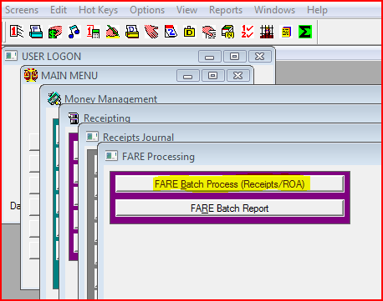
FARE Batch Processing
AZTEC 1.5.3
Navigation to FARE Batch Processing:
Main Menu → Money Management → Receipting → Receipts Journal → FARE Processing

Slide 3
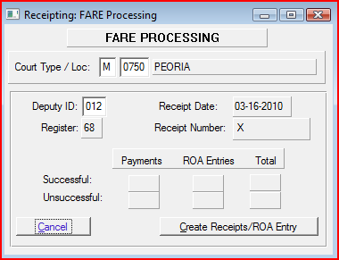
FARE Batch Processing
AZTEC 1.5.3
To run the FARE Batch Process:
  The court type and location will default to your court
  Enter your deputy number
  Select the “Create Receipts/ROA Entry” button to start
This will initiate the batch for FARE WEB/IVR Payments and the ROA docket event updates.
Please make sure you have your WEB/IVR payment report from your FARE Mailbox available to verify that all payments were posted correctly.
Please do not try to force the batch to run when the “Create Receipts/ROA Entry” button is disabled.

Slide 4
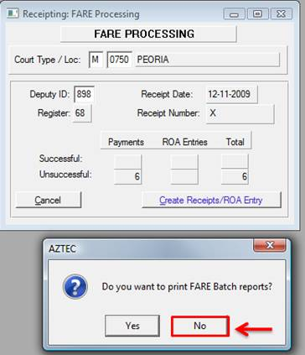
FARE Batch Processing
AZTEC 1.5.3
Once the batch process has completed you will notice the number of successful/unsuccessful number of payments, ROA entries and total.
You will also receive a pop up message if you wish to print the FARE Batch Report.
If you wish to print a report for the records that have processed please do not print from this pop up screen. Cancel the print from this screen then back out and print from the FARE Batch report screen.
Please select “No” when prompted to print the FARE Batch Report.

Slide 5
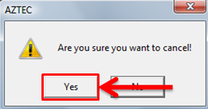
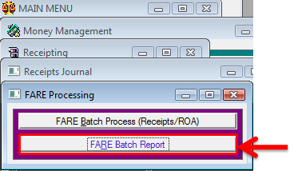
FARE Batch Processing
AZTEC 1.5.3
You will then get another pop up message asking “Are you sure you want to cancel!” select “Yes” to cancel.
To run the “FARE Batch Report” please navigate back to the “FARE Processing” screen (MAIN MENU→ MONEY MANAGEMENT→ RECEIPTING→ RECEIPTS JOURNAL→ FARE PROCESSING). Select the “FARE Batch Prcoessing Report” from here.

Slide 6
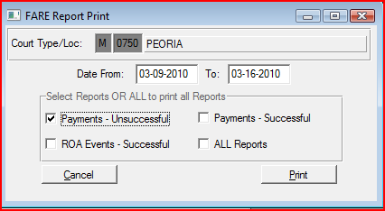
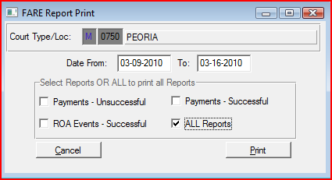
FARE Batch Processing
AZTEC 1.5.3
When printing the FARE batch report you can select to print any one of the 3 reports if there are transactions on that report:
  Unsuccessful Payments
  Successful Payments
  Successful ROA events
Please select the date range for the records that you wish to print.
  Note: any records older than 7 days will no longer be available.
Please use the “Tab” key to navigate through all the fields. You can use the “Spacebar” key to check or uncheck any of the reports you wish to print then tab over to the “Print” button and you can hit either the “Spacebar” or “Enter” key to print the report.
If you wish to print all reports check the “all reports” box and select print.
  You can also hit F4 to select all the reports and then hit print.

Slide 7
FARE Batch Processing
AZTEC 1.5.3
IMPORTANT!
The FARE Batch process must be run daily to ensure all receipts and ROA events (collection notices, TTEAP holds and releases) are processed
Records older than 7 days will no longer be available for FARE Batch Process
  Web/IVR payments that were not processed within this time frame will have to be receipted manually using the WEB/IVR payment report available in the FARE Mailbox
Records processed through FARE Batch Process will no longer be available for printing after 7 days

Slide 8
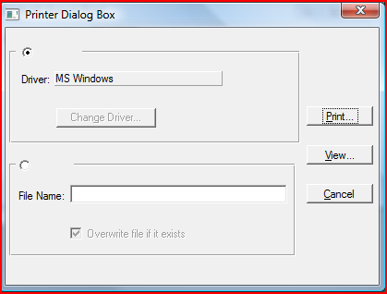
FARE Batch Processing
AZTEC 1.5.3
Popup message appears enabling the user to:
  Print the FARE Batch Report
  View the FARE Batch Report
  Cancel the FARE Batch Report

Slide 9
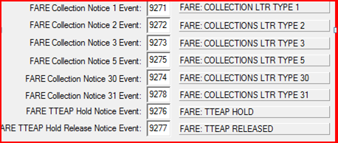
FARE Batch Processing
AZTEC 1.5.3
Here are the docket event codes that will appear on both the report for ROA events and on the ROA when docketed through the FARE Batch Process.
Types of Notices:
  Notice Type 1 = 1st Notice
  Notice Type 2 = 2nd Notice
  Notice Type 3 = 3rd Notice
  Notice Type 5 = 4th Notice
  Notice Type 30 = 5th Notice
  Notice Type 31 = 6th Notice

Slide 10
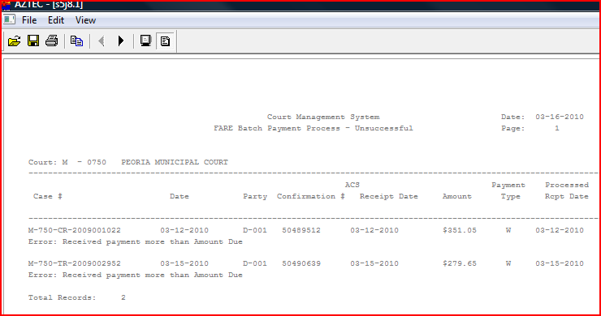
FARE Batch Processing
AZTEC 1.5.3
Unsuccessful payment details (errors) appear on the first page of the report
  This page will not appear if no errors occurred during batch process
  Errors on case must be corrected prior to continuing
After correcting the error on the case either:
  Rerun batch process for that transaction
  Receipt payment manually

Slide 11
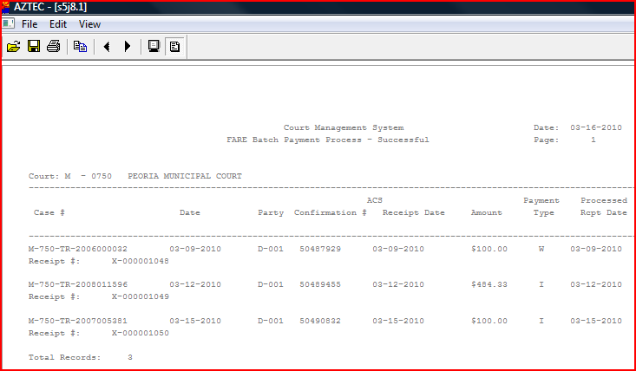
FARE Batch Processing
AZTEC 1.5.3
Successful payments report and the details of the payments will appear on the following pages
  If there was no unsuccessful report the successful report will be on the first pages

Slide 12
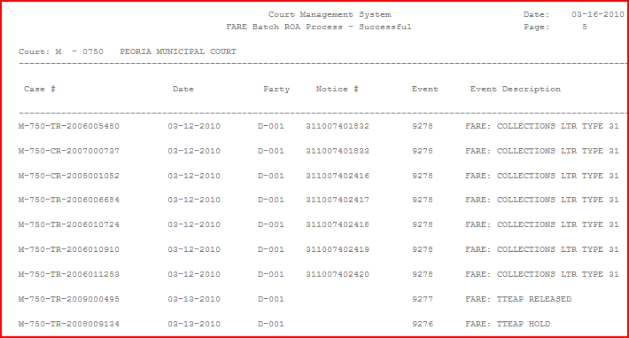
FARE Batch Processing
AZTEC 1.5.3
The FARE Batch ROA Process report will display all the ROA docket events processed during the FARE Batch Process.

Slide 13
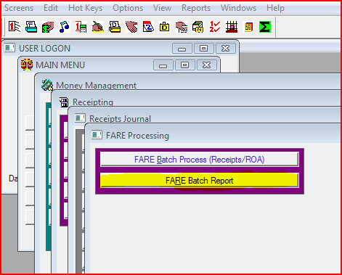
FARE Batch Processing
AZTEC 1.5.3
Navigation to reprint the FARE Batch Report:
  Main Menu → Money Management → Receipting → Receipts Journal → FARE Processing. Here select FARE Batch Report.

Slide 14
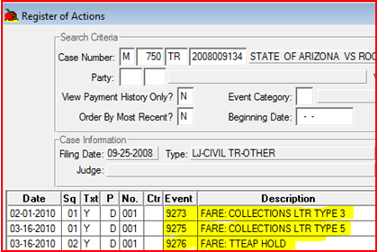
FARE Batch Processing
AZTEC 1.5.3
Example of ROA docket events on register of actions processed via the FARE Batch Process.
  Displays letter types and TTEAP holds/releases
Pressing F5 on any event allows viewing of descriptive text for selected event.

Slide 15
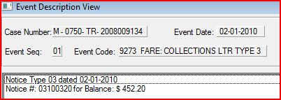
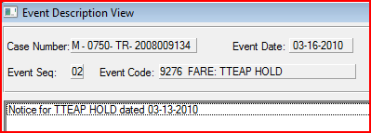
FARE Batch Processing
AZTEC 1.5.3
Example of F5 detail on a collection letter event
The descriptive text will display:
  Notice Type
  Notice date
  Notice number
  Balance
Example of F5 detail on a TTEAP Hold/Release
The descriptive text on a TTEAP hold/release will display:
  the date the TTEAP hold or release took place
Please note:
  The event date reflects the batch process run date
  The date displayed in the F5 detail reflects the date action took place

Slide 16
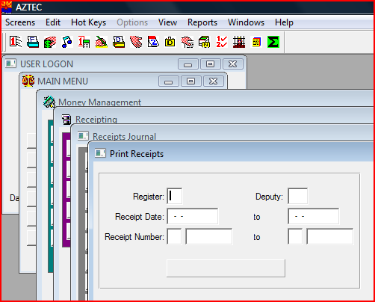
FARE Batch Processing
AZTEC 1.5.3
Receipts will not automatically print when generating/printing the FARE Batch Report
Navigation to print receipts processed during the FARE Batch Process:
  Main Menu → Money Management → Receipting → Receipts Journal → Print Receipts

Slide 17
FARE Batch Processing
AZTEC 1.5.3
If you have any issues or questions running the FARE Batch Process please contact the support center at 602-452-3519 or 1-800-720-7743 and have them route the remedy ticket to the FARE Program.
Please remember not to use the mouse and do not hit the “Enter” or “Tab” key fast or hold it down continously.

